Slide 1

History of Ethiopia and The Horn , HIES 2010
CHAPTER ONE ; PRESENTATIONS (1 hour ;25 minutes)
UNIT OBJECTIVES
Informing Students - 50 % Conceptual , inquiry (what is history , nature of History and uses of History ) , Historiography ,Transformation –
Professionalization of History -Skill part –(Critical Analysis of Sources )
Nature Of Presentation _ Lecture and Inquiry, Group discussion—
Skill part –(Critical Analysis of Sources )
-

Slide 2

HISTORY OF ETHIOPIA AND THE HORN, HiES2010

Slide 3
INTRODUCTION 1.1.ORIGIN OF The TERM
The term history derived from the Greek word Istoria, means “inquiry” or “an account of one’s inquiries.” The first use of the term is attributed to one of the ancient Greek historians, Herodotus (c. 484–425 B.C), who is often held to be the “father of history.”

Slide 4
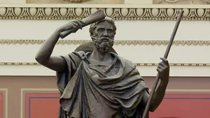
Herodotus (c. 484–425 B.C),

Slide 5
….WHAT IS HISTORY ?
Academically, history can be defined as an organized and systematic study of the past. The study involves the discovery, collection, organization, and presentation of information about past events
In this regard, the major concern of history is the study of human society and its interaction with the natural environment, which is also the subject of study by many other disciplines.

Slide 6
NATURE OF HISTORY
What differentiates history from other disciplines is that while the latter study the interaction between humans and their environment in the present state, history studies the interaction between the two in the past within the framework of the continuous process of change taking place in time.

Slide 7
Sources Of History
The work of historians must be supported by evidence arising from sources. Sources are instruments that bring to life what appear to have been dead. It is said that “where there are no sources, there is no history”. Sources are, therefore, key to the study and writing of history.
Historical sources are broadly classified into two types: Primary and Secondary.
Primary sources are surviving traces of the past available to us in the present. They are original or first hand in their proximity to the event both in time and in space. Examples of primary sources are manuscripts (handwritten materials), diaries, letters, minutes, court records and administrative files, travel documents, photographs, maps, video and audiovisual materials, and artifacts such as coins, fossils, weapons, utensils, and buildings.
Secondary sources, on the other hand, are second-hand published accounts about past events. They are written long after the event has occurred, providing an interpretation of what happened, why it happened, and how it happened, often based on primary sources. Examples of secondary sources are articles, books, textbooks, biographies, and published stories or movies about historical events

Slide 8
1.2.Uses of STUDYING HISTORY
Peoples live in the present and they plan for and worry about the future. History, however, is the study of the past. Why bother with the past while living in the present and anticipating what is yet to come?
1. History Helps Better Understand the Present
2. History Provides a Sense of Identity

Slide 9
… Uses of STUDYING History
3.History Teaches Critical Skills
Studying history helps students to develop key research skills. These include how to find and evaluate sources; how to make coherent arguments based on various kinds of evidence and present clearly in writing. These analytical and communication skills are highly usable in other academic pursuits. Gaining skills in sorting through diverse interpretations is also essential to make informed decisions in our day-to-day life.
4. History Helps Develop Tolerance and Open-Mindedness
5. History Supplies Endless Source of Fascination

Slide 10
1.3.Sources and Methods of Historical Studies
Historical sources are broadly classified into two types: Primary and Secondary.
1.Primary sources are surviving traces of the past available to us in the present. They are original or first hand in their proximity to the event both in time and in space. Examples of primary sources are manuscripts (handwritten materials), diaries, letters, minutes, court records and administrative files, travel documents, photographs, maps, video and audiovisual materials, and artifacts such as coins, fossils, weapons, utensils, and buildings.
2. Secondary sources, on the other hand, are second-hand published accounts about past events. They are written long after the event has occurred, providing an interpretation of what happened, why it happened, and how it happened, often based on primary sources.

Slide 11
… Sources and Methods of Historical Studies
Examples of secondary sources are articles, books, textbooks, biographies, and published stories or movies about historical events. Secondary materials give us what appear to be finished accounts of certain historical periods and phenomena. Nevertheless, no history work can be taken as final, as new sources keep coming to light. New sources make possible new historical interpretations or entirely new historical reconstructions.

Slide 12
Skill Part (35%) 1.4. Critical Analysis of Sources
For the history of Ethiopia and the Horn, historians use a combination of the sources described above. However, whatever the source of information-primary or secondary, written or oral- the data should be subjected to critical evaluation before used as evidence.
Primary sources have to be verified for their originality and authenticity because sometimes primary sources like letters may be forged. Secondary sources have to be examined for the reliability of their reconstructions. Oral data may lose its originality and authenticity due to distortion through time. Therefore, it should be crosschecked with other sources such as written documents to determine its veracity or authenticity. In short, historians (unlike novelists) must find evidence about the past, ask questions of that evidence, and come up with explanations that make sense of what the evidence says about the people, events, places and time periods they study about.

Slide 13
WHAT DOES HISTORIOGRAPHY MEAN :
MEANING
Historiography can be defined as the history of historical writing, studying how knowledge of the past, either recent or distant, is obtained and transmitted.

Slide 14
Historiographical TRADITIONS :GLOBAL AND CONTINENTAL SETTINGS
1. GREECE TRADITIONS
The organized study and narration of the past was introduced by ancient Greek historians notably Herodotus and Thucydides (c.455-400 B.C.E.) .
2.CHINESE TRADITIONS
The other major tradition of thinking and writing about the past is the Chinese. The most important early figure in Chinese historical thought and writing was the Han dynasty figure Sima Qian (145–86 B.C.E.).
3.ETHIOPIAN TRADITION

Slide 15
…Historiography of Ethiopia and the Horn
History emerged as an academic discipline in the second half of the nineteenth century first in Europe and subsequently in other parts of the world including the US.
The German historian, Leopold Von Ranke (1795–1886), and his colleagues established history as an independent discipline in Berlin with its own set of methods and concepts by which historians collect evidence of past events, evaluate that evidence, and present a meaningful discussion of the subject. Ranke’s greatest contribution to the scientific study of the past is such that he is considered as the “father of modern historiography.”

Slide 16
…Historiography of Ethiopia and the Horn
The earliest known reference that we have on history of Ethiopia and the Horn is the Periplus of the Erythrean Sea, written in the first century A.D by an anonymous author. Another document describing Aksum’s trade and the then Aksumite king’s campaigns on both sides of the sea is the Christian Topography composed by Cosmas Indicopleustes, a Greek sailor, in the sixth century A.D.

Slide 17
THE ETHIOPIAN TRADITION : NATIONAL SETTING 1.6. Sources On Ethiopian History : HAGIOGRAPHIES AND KITABS
Inscriptions aside, the earliest written Ethiopian material dates from the seventh century A.D. The document was found in Abba Gerima monastery in Yeha. This was followed by a manuscript discovered in Haiq Istifanos monastery of present day Wollo in the thirteenth century A.D. The value of manuscripts is essentially religious. Yet, for historians, they have the benefit of providing insights into the country’s past.
For example, the manuscript cited above contains the list of medieval kings and their history in brief. The largest groups of sources available for medieval Ethiopian history are hagiographies originating from Ethiopian Orthodox Church. Invariably written in Ge’ez, an important function of hagiographies is enhancing the prestige of saints.

Slide 18
1.6.1.HAGIOGRAPHIES AND KITABS
A parallel hagiographical tradition existed among Muslim communities of the country. One such account offers tremendous insight into the life of a Muslim saint, Shaykh Ja’far Bukko of Gattira, in present day Wollo, in the late nineteenth century. Besides the saint’s life, the development of indigenous Islam and contacts between the region’s Muslim community and the outside world are some of the issues discussed in this document.

Slide 19
….chronicles and KITABS
Ethiopia had also an indigenous tradition of history writing called chronicles. Chronicles in the ancient Ethiopian Ge’ez tongue first appeared in the fourteenth century and continue (sometimes in Amharic) into the early twentieth. Kings or their successors entrusted the writing of chronicles to court scribes or clergymen of recognized clerical training and calligraphic skills.
The earliest and the last of such surviving documents are the Glorious Victories of Amde-Tsion and the Chronicle of Abeto Iyasu and Empress Zewditu respectively. Chronicles incorporate both legends and facts-past and contemporary about the monarch’s genealogy, upbringing military exploits, piety and statesmanship. Chronicles are known for their factual detail and strong chronological framework, even if it would require considerable labor to convert their relative chronology to an absolute one. It is also averse to quantification, have a limitatiom ( Bias and Chronology ).

Slide 20
1.6.2. Arabic Documents
For example, al-Masudi and Ibn Battuta described the culture, language and import-export trade in the main central region of the east African coast in the tenth and in the fourteenth centuries respectively. For the 16th and17th centuries we have two documents composed by Yemeni writers who were eyewitnesses to the events they described. The first document titled Futuh al Habesha was composed by Shihab al-Din, who recorded the conflict between the Christian kingdom and the Muslim principalities in the sixteenth century.
The other first-hand account was left to us by Al-Haymi, who led a Yemeni delegation in 1647 to the court of Fasiledas (r. 1632-67).

Slide 21
1.6.3.Travel ACCOUNT
The contribution of European missionaries and travelers to the development of Ethiopian historiography is also significant. From the early sixteenth until the late nineteenth centuries, missionaries (Catholics and Protestants) came to the country with the intention of staying, and who, nevertheless, maintained intimate links with Europe.
Thus, the missionaries’ sources provide us with valuable information covering a considerable period. Some of the major topics covered by these sources include religious and political developments within Ethiopia, and the country’s foreign relations. An example of such account is The Prester John of the Indies, composed by a Portuguese priest, Francisco Alvarez who accompanied the Portuguese mission to the court of Lebne-Dengel in 1520.

Slide 22
…Travel ACCOUNT
In addition to the missionary sources, travel documents had important contribution to the development of Ethiopian historiography.
One example of travel documents is James Bruce’s Travels to Discover the Source of the Nile. Like other sources, however, both the missionaries and travelers’ materials can only be used with considerable reservations and with care for they are socially and politically biased.

Slide 23
1.7.The professionalization of history in other parts of the Horn
The professionalization of history in other parts of the Horn is a post-colonial phenomenon. With the establishment of independent nations, a deeper interest in exploring their own past quickly emerged among African populations, perhaps stimulated by reactions to decades of education in an alien imperial historiography.
With this came an urgent need to recast the historical record and to recover evidence of many lost pre-colonial civilizations. The decolonization of African historiography required new methodological approach (tools of investigation) to the study of the past that involved a critical use of oral data and tapping the percepts of ancillary disciplines like archeology, anthropology and linguistics.

Slide 24
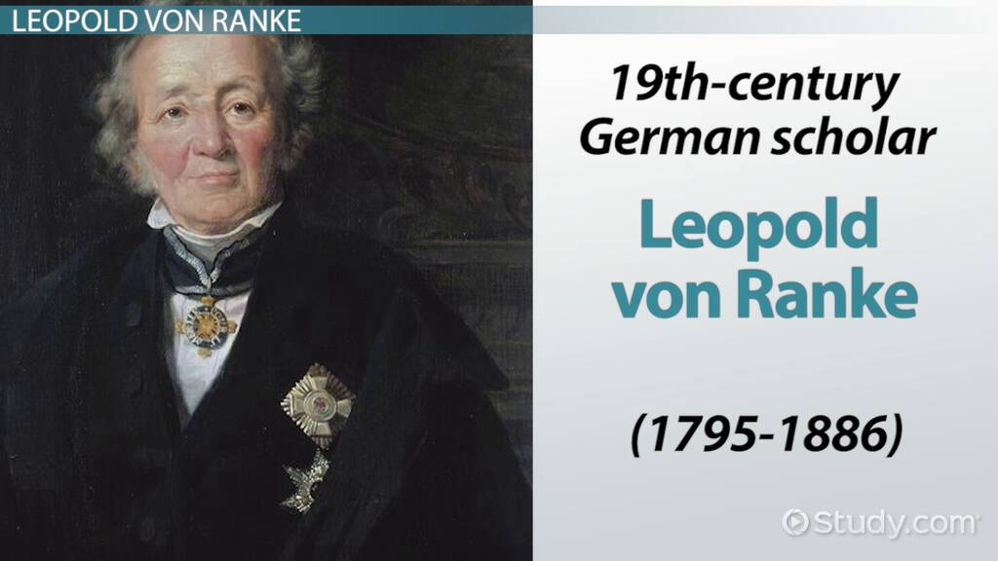

Slide 25
Leopold von Ranke (Wiehe 12 December 1795 - Berlin 23 May 1886)
Rankie did not invent the footnote, or the concept of primary sources. His archival researches were revolutionary in implication, but his own writings did not fully exemplify the ideal of "scientific" history. He was a temptation to a historian, though he rejected the misty teleology of Hegel (at Berlin, he and Hegel defined the two principal opposing factions among the faculty). And he ignored other schematisms, confident that any larger movements would emerge from careful study of the details.
?

Slide 26
1.8. Geographical Context
The term “Ethiopia and the Horn” refers to that part of Northeast Africa, which now contains the countries of Djibouti, Eritrea, Ethiopia, and Somalia. The region consists chiefly of mountains uplifted through the formation of the Great Rift Valley.
The major physiographic features of the region are a massive highland complex of mountains and plateaus divided by the Great Rift Valley and surrounded by lowlands, semi-desert, deserts and tropical forests along the periphery. The diversity of the terrain led to regional variations in climate, natural vegetation, soil composition, and settlement patterns. As with the physical features, people across the region are remarkably diverse: they speak a vast number of different languages, profess to many distinct religions, live in a variety types of dwellings, and engage in a wide range of economic activities.

Slide 27
… Geographical Context
The history of Ethiopia and the Horn has been shaped by contacts with others through commerce, migrations, wars, slavery, colonialism, and the waxing and waning of state systems. Yet, the evolution of human history owed much to geographical factors notably location, landforms, resource endowment, climate and drainage systems which continue to impact, as incentives and deterrents, the movement of people and goods in the region.
Another element of geography factor that had profound impact on human history is drainage system. Ethiopia and the Horn has five principal drainage systems. These are the Nile River, Gibe/Omo–Gojeb, Genale/Jubba-Shebele, the Awash River,and the Ethiopian Rift Valley Lakesystems. Ethiopia and the Horn can be divided into three major distinct environmental zones

